Slide 1
Design Patterns
Units
  GOF Creational Patterns
  GOF Structural Patterns
  GOF Behavioral Patterns
Module: Design Patterns Copyright © Venkat Shiva Reddy

Slide 2

Unit 1
GOF Creational Patterns
Module: Design Patterns Copyright © Venkat Shiva Reddy

Slide 3
GOF Creational Patterns
Topics
  Introduction to Design Patterns
  Factory Method
  Singleton
  Abstract Factory
Module: Design Patterns Copyright © Venkat Shiva Reddy

Slide 4
Design Patterns
An introduction…
Module: Design Patterns Copyright © Venkat Shiva Reddy

Slide 5
Introduction to Design Patterns
Words of wisdom from Dr. Eric Gamma
  A good design should be specific to the problem at hand, but also address future problems and requirements
  Avoid redesign, at least minimize it
  A reusable and flexible design is difficult of not impossible to get ‘right’ the first time
    Design iteratively for a given degree of complexity
  Expert designers do not solve every problem from first principles. They reuse solutions that have worked for them in the past
Ability to relate to design patterns would be a good measure of how much Object Oriented a developer is
Module: Design Patterns Copyright © Venkat Shiva Reddy

Slide 6
A brief history of patterns
The idea of software patterns originally came from the field of architecture
Christopher Alexander, an architect, wrote two revolutionary books that describe patterns in building architecture and urban planning
  A Pattern Language: Towns, Buildings, Construction
  The Timeless Way of Building
In 1987, Ward Cunningham and Kent Beck used some of Alexander’s ideas to develop five patterns for UI design
  Published a paper on the UI patterns at OOPSLA-87 entitled ‘Using Pattern Languages for Object-Oriented Programs’
Module: Design Patterns Copyright © Venkat Shiva Reddy

Slide 7

A brief history of patterns
GoF
Patterns
In the early 1990s,
  Erich Gamma,
  Richard Helm,
  Ralph Johnson, and
  John Vlissides
  began one of the most influential computer books of the decade: ‘Design Patterns’
The four are popularly known as the Gang of Four (GoF) and the patterns cataloged are known as the GoF patterns
The book presented a catalog of patterns
  The catalog began as part of Erich’s Ph.D. thesis
Roughly half of the patterns stated in the book were in his thesis
Module: Design Patterns Copyright © Venkat Shiva Reddy

Slide 8
GOF Design Patterns
By OOPSLA ’91 it was officially an independent catalog, and Richard had joined Erich to work on it
John started working on it soon thereafter
By OOPSLA ’92, Ralph had joined the group
The names of a few patterns were revised and couple of them were omitted as they didn’t seem important enough
  Wrapper became Decorator
  Glue became Façade
  Solitaire became Singleton
  Walker became Visitor
The book presents the code examples for the patterns in Smalltalk and C++
The representations are made in OMT methodology proposed by James Rumbaugh as UML did not exist then
Module: Design Patterns Copyright © Venkat Shiva Reddy

Slide 9
GOF Design Patterns
The GOF book presents a catalog of 23 patterns which are classified as
  Creational Patterns
  Structural Patterns
  Behavioral Patterns
The patterns are identification of reusable designs used by designers for several years
The context of the problem that a pattern addresses would be as important to understand as the pattern itself which is only a proven solution to the problem
The patterns would be a simple assembly of the first principles, design fundamentals, keeping in mind the impact of code change and maintainability
Module: Design Patterns Copyright © Venkat Shiva Reddy

Slide 10
The philosophy of Creational Patterns
One of the fundamental principles of a good design is ‘program to an interface and not to an implementation’
Like how extensive use of inheritance commits you to implementations and not to interface, creation of an object would also commit you to an implementation
So how would you create an instance of a class without committing to an implementation?
  Encapsulate the creation within methods, so that the methods can be captured on a interface and a class can implement these methods
  The programmer can thereby use an instance of the interface to create an object and possibly stay decoupled from the implementation (class)
  The fundamental philosophy of course, would be to encapsulate ‘new’ within a method
Module: Design Patterns Copyright © Venkat Shiva Reddy

Slide 11
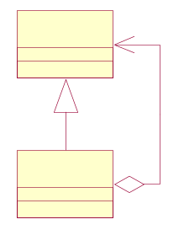
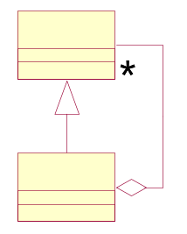
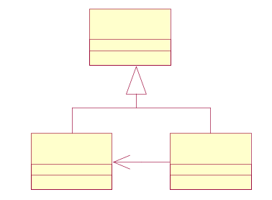
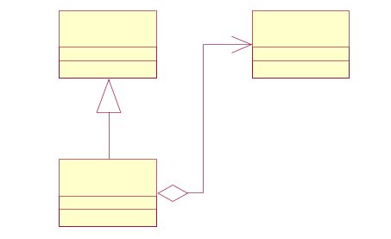
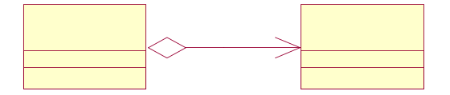
The philosophy of Structural Patterns
Designing class structures would involve deciding on ‘is-a’ and ‘has-a’ relationships to achieve the required level of maintainability
Structural patterns suggest how to combine ‘is-a’ and ‘has-a’ relationships to solve complex problems
The context would again be the deciding factor to identify the pattern applied and not simply the code implementation as combinations of ‘is-a’ and ‘has-a’ relationships would look identical
Module: Design Patterns Copyright © Venkat Shiva Reddy

Slide 12
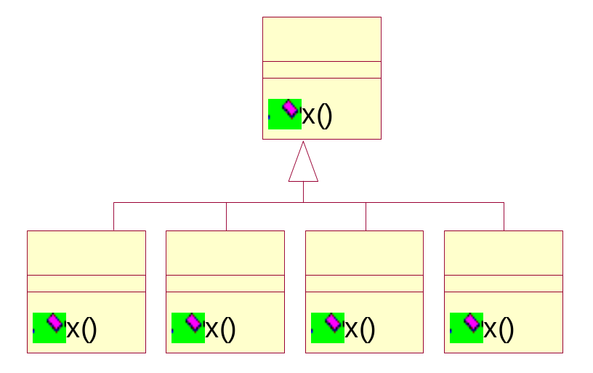
The philosophy of Behavioral Patterns
A class is an encapsulation of structure and behavior. Typically, new types of behavior (implementations) may need to be added to a class
This would make the class unstable if all the implementations are added to the same class and methods provide implementations for each type by employing set of if-else-if structures
In certain cases, it would be improbable to capture all the methods of a class as new operations would be added based on need
In all these above cases, the classes would go through multiple changes
Behavioral patterns encapsulate every new behavior or set of related methods in new classes so that adding new classes is simpler than changing existing classes and handling their dependencies
The simple solution to the problem is to employ runtime polymorphism and provide different implementations in different classes
Module: Design Patterns Copyright © Venkat Shiva Reddy

Slide 13
Categories Of GOF Patterns
Creational: concern the process of object creation
Structural: deal with the composition of classes or objects
Behavioral: characterize the ways in which classes or objects interact and distribute responsibility

Slide 14
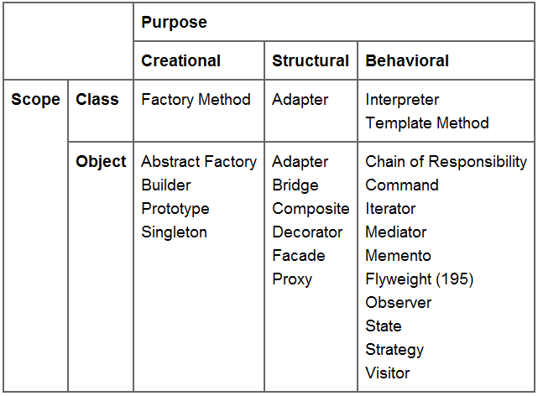
Catalog of GoF Patterns

Slide 15
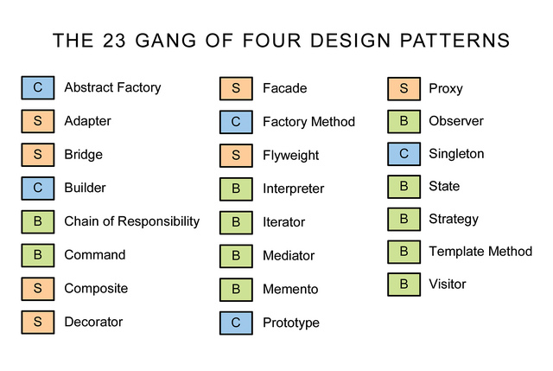

Module: Design Patterns Copyright © Venkat Shiva Reddy

Slide 16
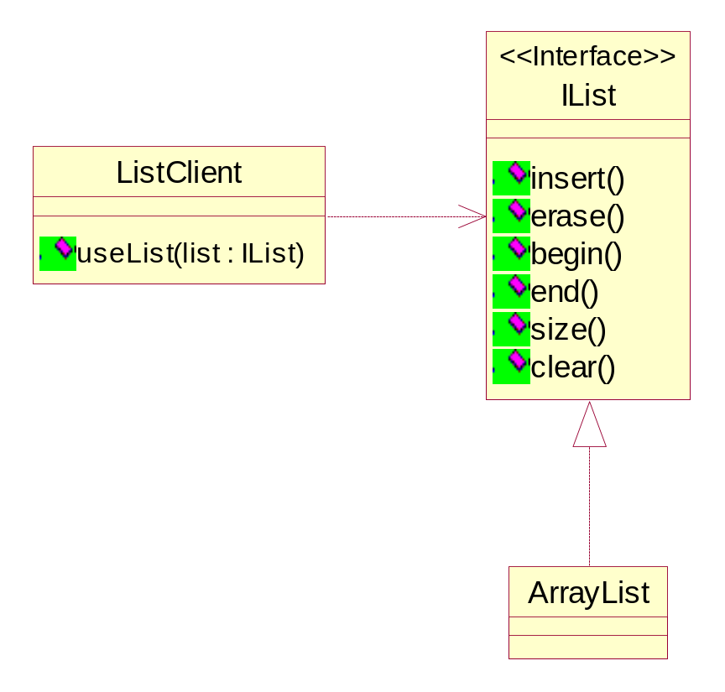
Factory Method
Consider the following problem
  In the ‘Collections framework’, an ‘IList’ interface has been defined which all list sub-classes implement
ArrayList class is a type of list and implements the interface IList
In the clients’ code the ArrayList class can be abstracted as a type of IList
Module: Design Patterns Copyright © Venkat Shiva Reddy

Slide 17
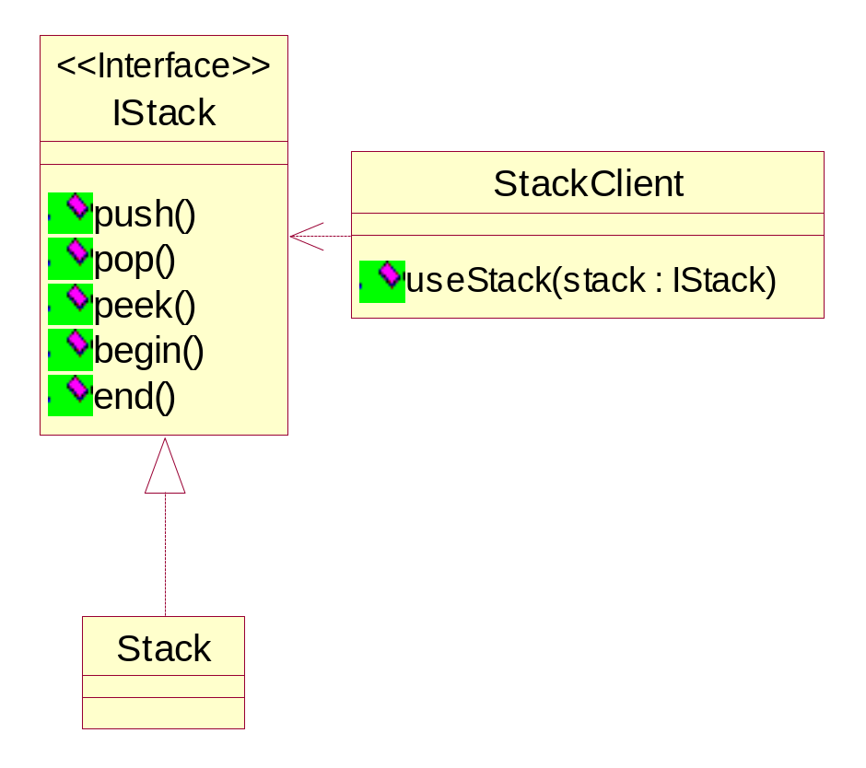
Factory Method
Let us know suppose that a Stack class needs to be added to our ‘Collections framework’
The Stack class is however represented by the ‘IStack’ interface
It is hence necessary for the Stack class to provide a complete implementation for its interface
Stack being an ADT (Abstract Data Type) can be configured to use any underlying data structures which are lists
It would hence be feasible to reuse an ArrayList class implementation and map the methods of the Stack to the methods of ArrayList
Module: Design Patterns Copyright © Venkat Shiva Reddy

Slide 18
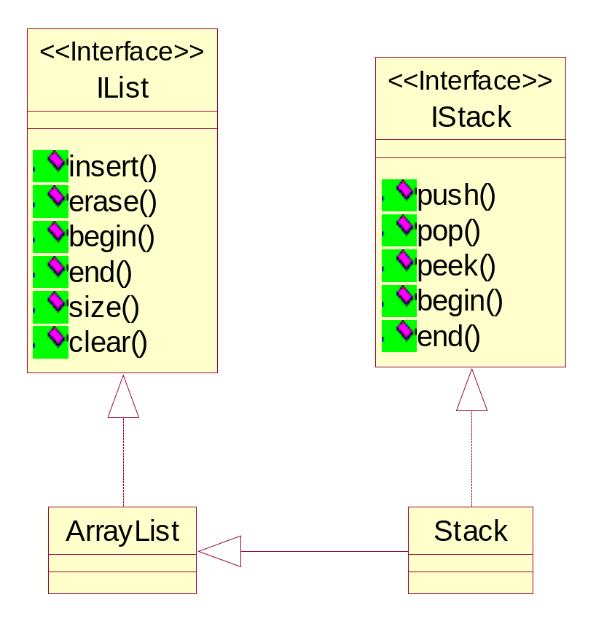

Factory Method
How would Stack use the ArrayList Class?
Model 1 Model 2
Module: Design Patterns Copyright © Venkat Shiva Reddy

Slide 19
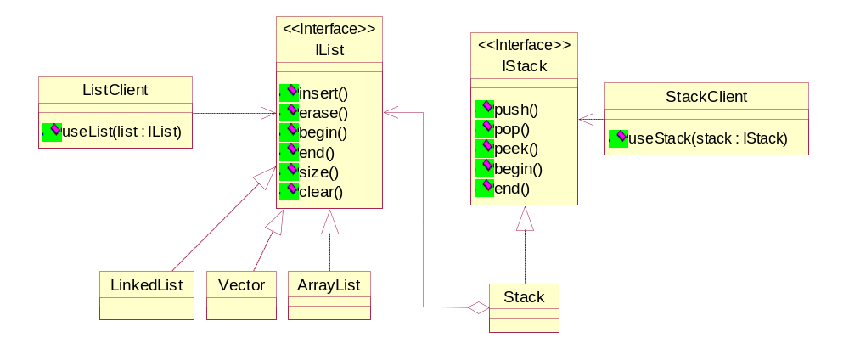
Factory Method
The Stack – ArrayList Solution
See listing StackArray
Module: Design Patterns Copyright © Venkat Shiva Reddy
Notes:
interface ListTypes
{
int FIXED = 1;
int VARIABLE = 2;
int RANDOM = 3;
}
interface IList
{
void insert();
void erase();
}
class Array implements IList
{
public void insert()
{
System.out.println("Array.insert");
}
public void erase()
{
System.out.println("Array.erase");
}
}
class LinkedList implements IList
{
public void insert()
{
System.out.println("LinkedList.insert");
}
public void erase()
{
System.out.println("LinkedList.erase");
}
}
class Vector implements IList
{
public void insert()
{
System.out.println("Vector.insert");
}
public void erase()
{
System.out.println("Vector.erase");
}
}
interface IStack
{
void push();
void pop();
}
class Stack implements IStack
{
IList list;
Stack()
{
list = new Array();
}
Stack(int type)
{
if(type==ListTypes.FIXED)
list = new Array();
else if(type==ListTypes.VARIABLE)
list = new LinkedList();
else if(type==ListTypes.RANDOM)
list = new Vector();
}
public void push()
{
System.out.println("Stack.push");
list.insert();
}
public void pop()
{
System.out.println("Stack.pop");
list.erase();
}
}
class ListClient
{
void use(IList list)
{
System.out.println("Inside List Client...");
list.insert();
list.erase();
}
}
class StackClient
{
void use(IStack stack)
{
System.out.println("Inside Stack Client...");
stack.push();
stack.pop();
}
}
class StackArray
{
public static void main(String args[])
{
ListClient listClient = new ListClient();
IList array = new Array();
listClient.use(array);
int type = Integer.parseInt(args[0]);
// 1. Fixed Size Stack
// 2. Variable Size Stack
// 3. Variable random access based Stack
IStack stack = new Stack(type);
StackClient stackClient = new StackClient();
stackClient.use(stack);
}
}

Slide 20
Factory Method
Problems in the implementation code
  The Stack class aggregates the IList and hence programs to an interface. This would ideally abstract the different implementations of IList from the Stack, which makes the Stack ADT more configurable. The following implementation code however does not achieve this.
    Stack() {
    list = new Array();
    }
    Stack(int type) {
    if(type==ListTypes.FIXED)
    list = new Array();
    else if(type==ListTypes.VARIABLE)
    list = new LinkedList();
    else if(type==ListTypes.RANDOM)
    list = new Vector();
    }
Module: Design Patterns Copyright © Venkat Shiva Reddy

Slide 21
Factory Method
As long as the Stack uses the methods of the IList interface, it remains decoupled from the implementation
If it needs to invoke any method that cannot be captured on the interface, then the Stack class gets coupled with the implementation
A constructor can however not be captured on the IList, and hence the Stack class needs to instantiate an actual implementation of IList, by invoking the constructor of the actual class while doing a ‘new’ on the class for creation
This is a creational problem
  Encapsulate new in a method which acts as a Virtual Constructor
Module: Design Patterns Copyright © Venkat Shiva Reddy

Slide 22
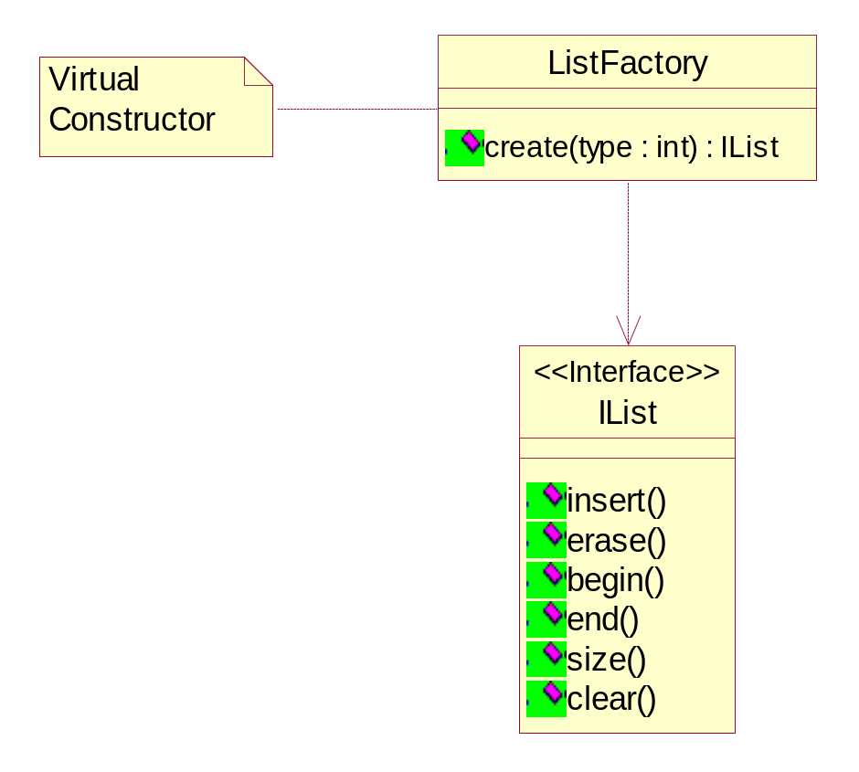
Factory Method
Objective
  Hide the number of products in a family (class hierarchy), so that the client programs to an interface and not to an implementation
Also Known as
  Virtual Constructor
Module: Design Patterns Copyright © Venkat Shiva Reddy

Slide 23
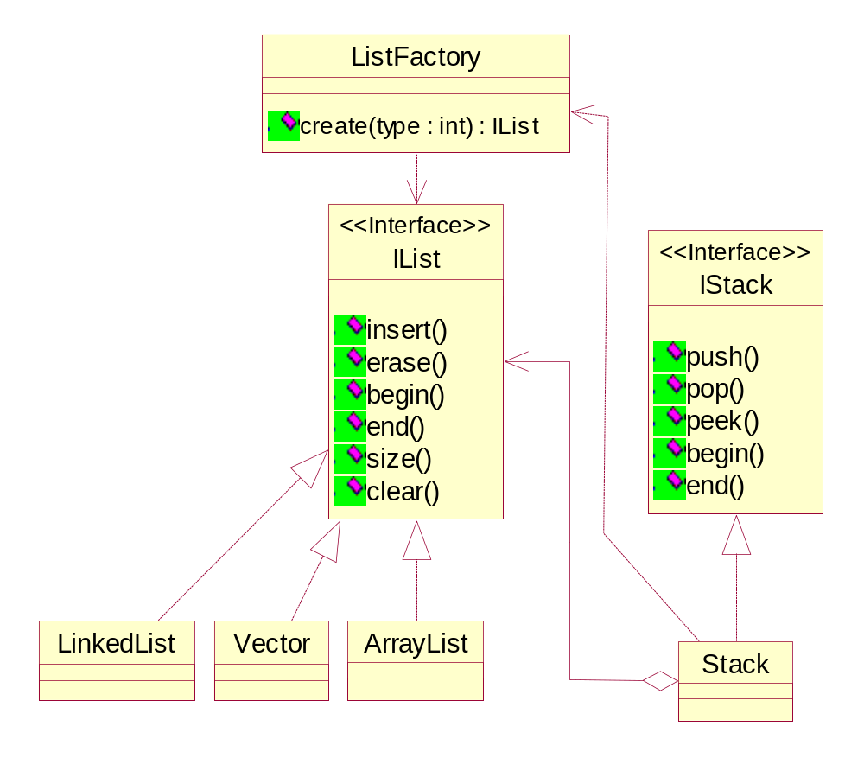
Using the Factory Method
Module: Design Patterns Copyright © Venkat Shiva Reddy

Slide 24
Factory Method
Using the factory, decouples the Stack Class from the IList implementation classes
It is best suited that in a framework, the developer of a package provides the factory to create the products
The clients commit to creating the products through the factory and hence phasing out products or introducing new types would be transparent to the clients
See listing StackArray2
See listing StackArray3
Module: Design Patterns Copyright © Venkat Shiva Reddy

Slide 25
Applying the Factory Method
Consider the following listing
  class AccMgr {
  void transact(String accNo,String name,double bal,int accType,int userType) {
  IAccount account;
  if(userType==UserTypes.SIMPLE) {
  if(accType==AccTypes.SAVINGS)
  account = new Savings();
  else if(accType==AccTypes.CURRENT)
  account = new Current();
  }
  else if(userType==UserTypes.SECURED) {
  account = new SecAccount(accType);
  }
  // else if…
  // else if…
  account.setAccNo(accNo);
  account.setName(name);
  account.open();
  }
  }
Module: Design Patterns Copyright © Venkat Shiva Reddy

Slide 26
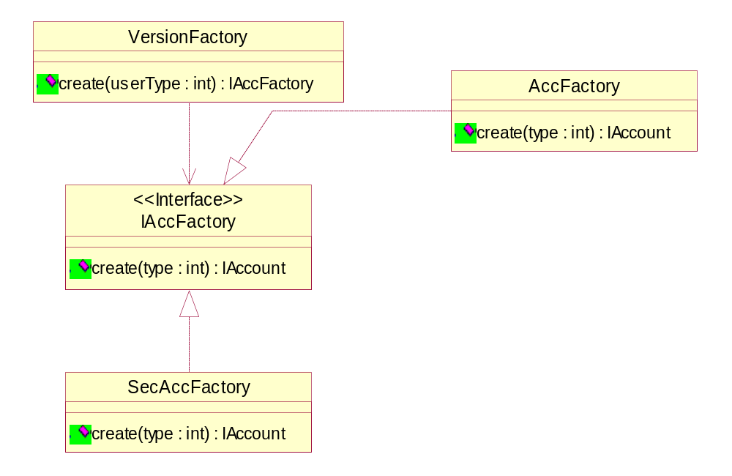
Applying the Factory Method
Define an interface to create an object, but let sub classes decide which class to instantiate - GOF
Module: Design Patterns Copyright © Venkat Shiva Reddy

Slide 27
Applying the Factory Method
How would the creational problems be solved based on the previous design?
  See SecAccounts.mdl for the complete solution
Study the maintainability achieved through the previous design
  See listing SecAcc2
  See listing SecAcc3
Module: Design Patterns Copyright © Venkat Shiva Reddy

Slide 28
The Singleton
Intent
  Ensure that a class has only one instance, and provide a global point of access to it
Objective
  Singletons are better than global instances in the sense that they cannot be instantiated more than once
  If a class has no state, then it would be a good candidate for a Singleton
  A class in this case could also have only static methods to avoid instantiation
  The static methods can however not be dispatched at runtime and the class is not extensible
  A maintainable and optimized equivalent of a class with only static methods is a singleton
Module: Design Patterns Copyright © Venkat Shiva Reddy

Slide 29
The Singleton
    class TaskManager
    {
    private static TaskManager instance;
    private TaskManager() {}
    static TaskManager getInstance()
    {
    if(instance==null)
    instance = new TaskManager();
    return instance;
    }
    }
The above code illustrates the classical singleton
The method getInstance() may have to be synchronized
See listing SingletonDemo1
Listing SingletonDemo2 illustrates a variation of the above listing
Module: Design Patterns Copyright © Venkat Shiva Reddy

Slide 30
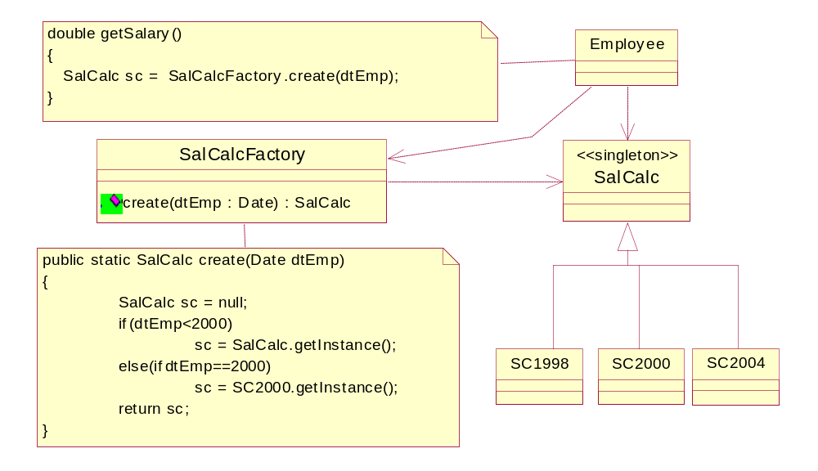
Singleton Class Hierarchies Problem
Module: Design Patterns Copyright © Venkat Shiva Reddy

Slide 31
Designing Singleton Hierarchies
In the previous design how would you make all the Salary Calculator subclasses singletons and thereby design a Singleton Hierarchy?
  This would essentially require all the subclasses to be singletons too
  The base class cannot have a default private constructor
GOF suggests two ways of creating the hierarchies
  Early initialization
  Lazy initialization
Whenever we have a singleton hierarchy then we can present a single class to the client, which can act as both the interface and the factory
  Essentially this would mean that the base class of the hierarchy will act like a factory
Module: Design Patterns Copyright © Venkat Shiva Reddy

Slide 32
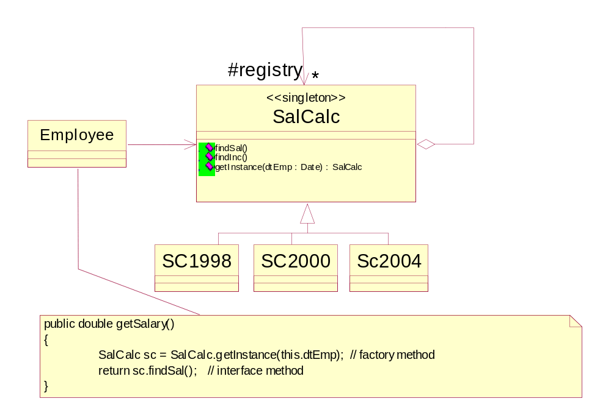
Singleton Class Hierarchies Solution
Module: Design Patterns Copyright © Venkat Shiva Reddy

Slide 33
Designing Singleton Hierarchies
The base class maintains a registry of instances
Simple structural auto collaboration for the pool
Early initialization
  See listing SingletonSubclass1
Lazy initialization
  See listing SingletonSubclass2
Module: Design Patterns Copyright © Venkat Shiva Reddy

Slide 34
Abstract Factory
Intent
  Provide an interface for creating families of related or dependent objects without specifying their concrete classes
Also known as
  Kit
Objective
  Hide the different families of representations of different products so that new families may be supported
  Allows the clients to access the products through the products’ interface without exposing their families (subclasses)
Module: Design Patterns Copyright © Venkat Shiva Reddy

Slide 35
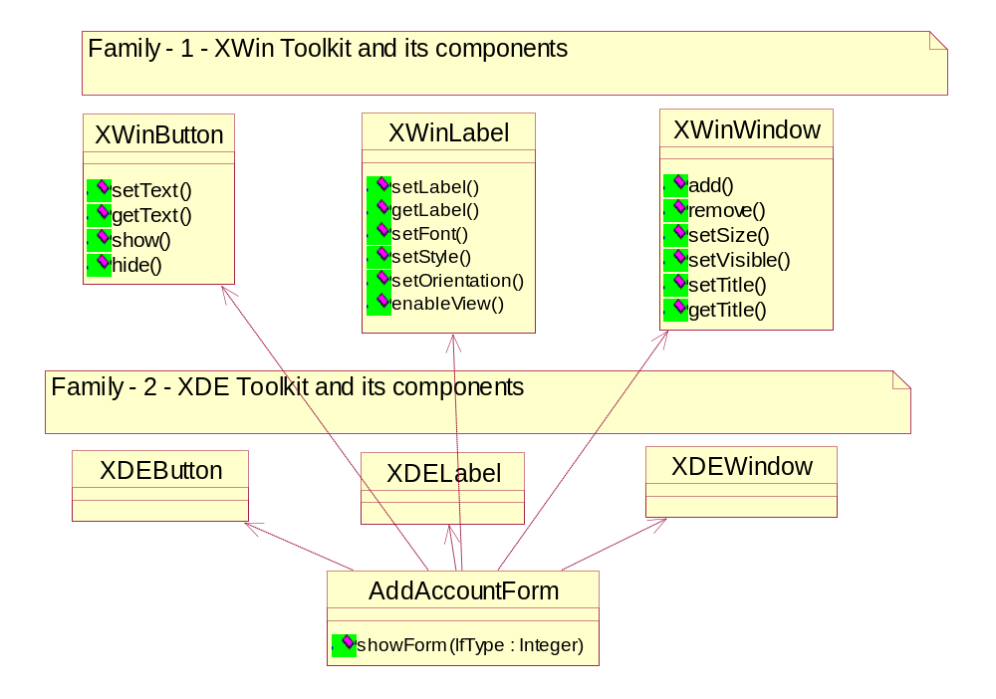
Abstract Factory – The Context
Consider the following problem where the AddAccountForm can create Button, Label, Window, etc. from different toolkits to provide Look And Feel Support
Module: Design Patterns Copyright © Venkat Shiva Reddy

Slide 36
Abstract Factory – The Context
In the previous case, the AddAccountForm would be tightly coupled with the XDEButton, XDELabel, XDEWindow, XWinButton, etc. as it would need to instantiate one of the components from the toolkit, in order to support the look and feel
  if(lfType==LookFeelTypes.XWIN) {
  XWinWindow w1 = new XWinWindow();
  XWinButton b1 = new XWinButton();
  XWinLabel l1 = new XWinLabel();
  w1.setVisible(true);
  b1.show();
  l1.enableView();
  }else if(lfType==LookFeelTypes.XDE) {
  XDEWindow w1 = new XDEWindow();
  XDEButton b1 = new XDEButton();
  XDELabel l1 = new XDELabel();
  w1.setVisible(true);
  b1.show();
  l1.enableView();
  }
See listing LookFeelDemo1.java
Module: Design Patterns Copyright © Venkat Shiva Reddy

Slide 37
Abstract Factory – The Context
The previous listing shows how difficult it is to incorporate another look and feel toolkit
This is a creational problem as the need to create objects from a given tool kit tightly couples the AddAccountForm to the different tool kits
The different families (XWin, XDE, etc.) can be abstracted and the client (AddAccountForm) can instead use the products (XDEButton, XDELabel, etc.) through their interfaces
Module: Design Patterns Copyright © Venkat Shiva Reddy

Slide 38
Rules for designing an Abstract Factory
1. Identify the products and the family
2. Group classes based on products and not by families.
3. In the regrouped class hierarchies, the base classes represent the products and their number of sub-classes represent the families.
4. Design one factory for each family.
5. Each factory explicitly creates as many products as the number of base classes,
ex.
class Factory1
{
ProdA createProdA();
ProdB createProdB();
ProdC createProdC();
}
6. Define a super-interface for all the factories known as the abstract factory.
7. The clients program to the interface Abstract Factory and use Abstract Products.
Module: Design Patterns Copyright © Venkat Shiva Reddy

Slide 39
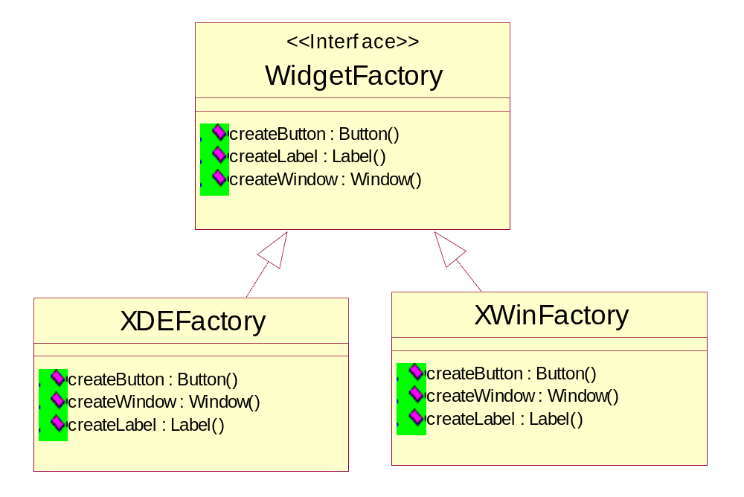
Designing the Abstract Factory
See LookAndFeelDemo2.mdl for complete design
See listing LookAndFeelDemo2
Module: Design Patterns Copyright © Venkat Shiva Reddy

Slide 40
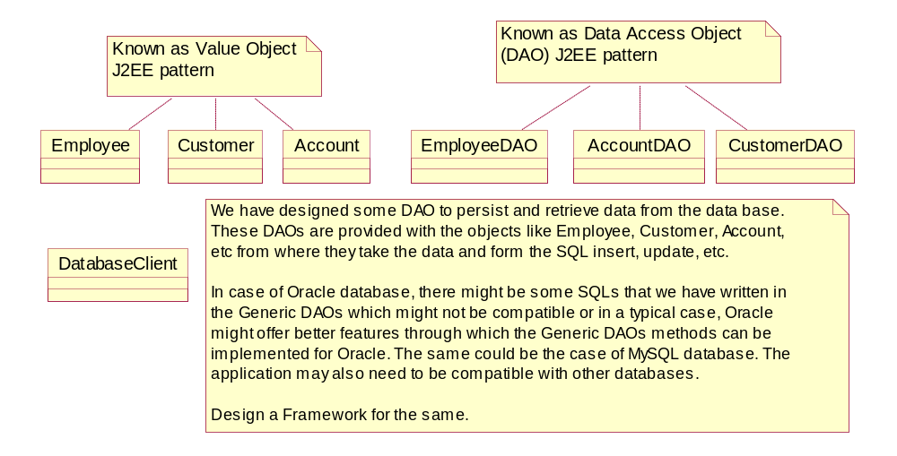
Designing a Persistence Framework
Module: Design Patterns Copyright © Venkat Shiva Reddy

Slide 41
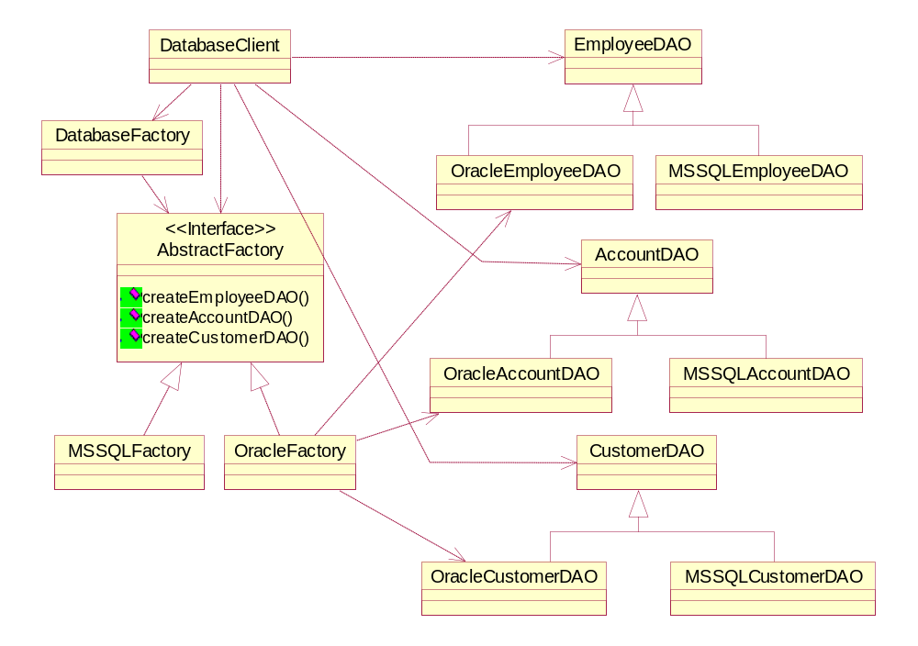
Persistence Framework to support multiple databases
Module: Design Patterns Copyright © Venkat Shiva Reddy

Slide 42

Question time
Please try to limit the questions to the topics discussed during the session.
Participants are encouraged to discuss other issues during the breaks.
Thank you.
Module: Design Patterns Copyright © Venkat Shiva Reddy

Slide 43
Unit 2
GOF Structural Patterns
Module: Design Patterns Copyright © Venkat Shiva Reddy

Slide 44
GOF Structural Patterns
Topics
  Bridge
  Flyweight
  Façade
  Adapter
  Proxy
Module: Design Patterns Copyright © Venkat Shiva Reddy

Slide 45
Bridge Pattern
Intent
  Decouple an abstraction from its implementation so that the two can vary independently
Also Known as
  Handle / Body
Module: Design Patterns Copyright © Venkat Shiva Reddy

Slide 46
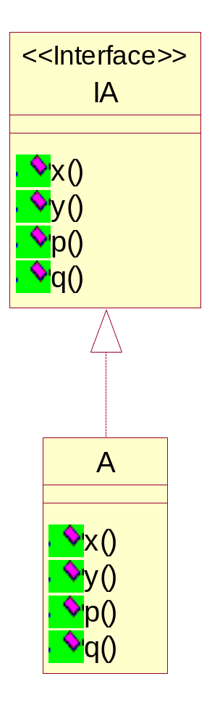
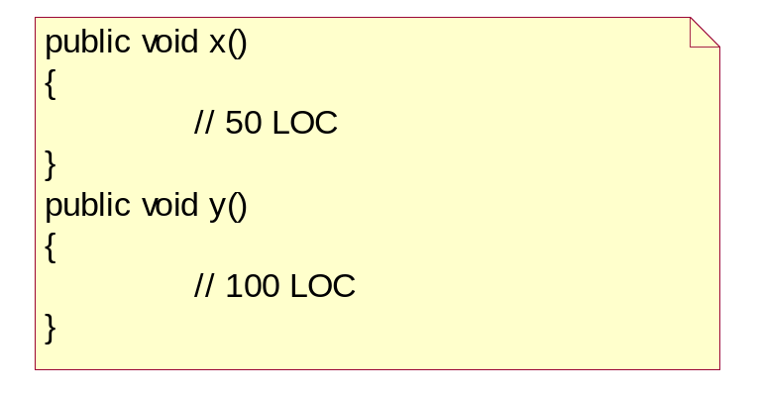
Bridge Pattern – The Context
Consider the class A which provides an implementation for all the methods of the interface
The class A in a typical case might have some structure and implementation which can be reused by other classes
Consider a case where part of the class A’s implementations – x() and y() are discovered to be shareable implementations across other classes
How would you share the implementations with other classes?
Module: Design Patterns Copyright © Venkat Shiva Reddy

Slide 47
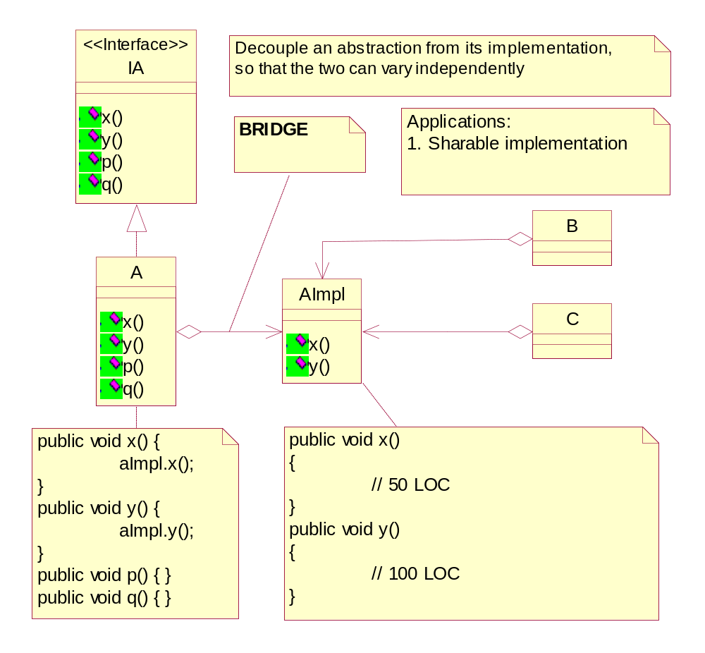
Bridge Pattern – The Solution
Module: Design Patterns Copyright © Venkat Shiva Reddy

Slide 48
Bridge Pattern – Multiple Implementers
With the bridge pattern, the implementation is decoupled from the class which has the abstraction
It is possible therefore to attach at runtime multiple implementers
This essentially means that all the classes that bridge with the Implementation can be configured with any implementer
Each class’s implementation can therefore vary without creating subclasses for each class
Essentially this way, it is possible to eliminate class proliferation in all the class hierarchies
Module: Design Patterns Copyright © Venkat Shiva Reddy

Slide 49
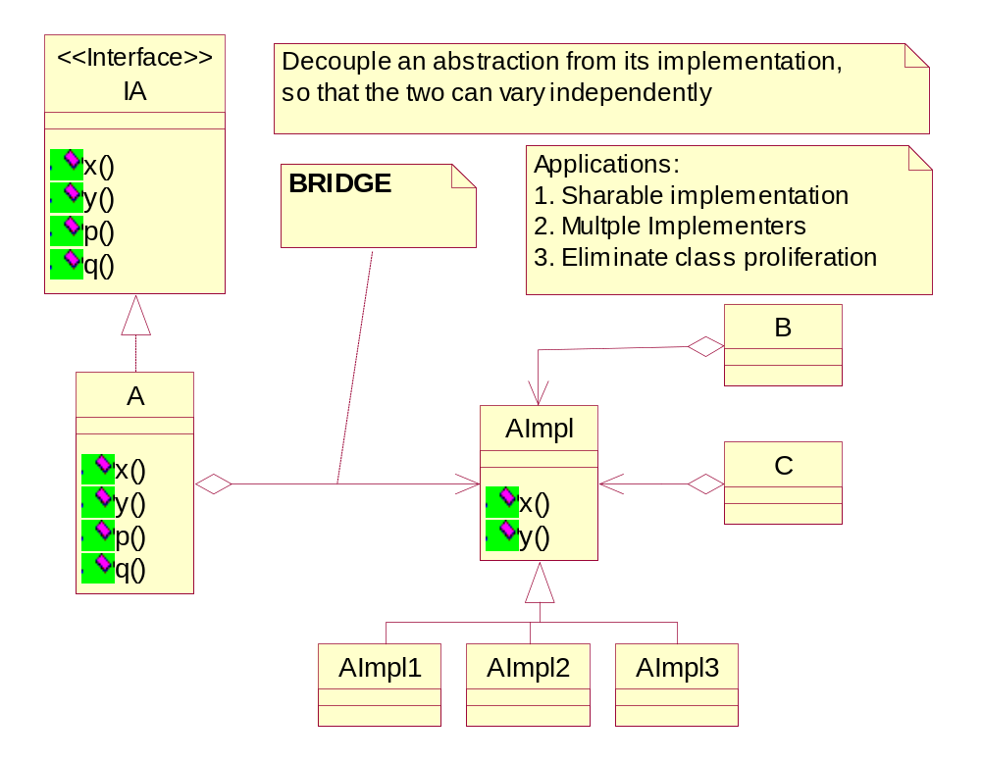
Bridge Pattern – Multiple Implementers
Module: Design Patterns Copyright © Venkat Shiva Reddy

Slide 50
Bridge Pattern - Applications
See BankApp Problem Statement
  Design the classes for the same
Requirements
  Provide an LSP interface ‘IAccount’ for accessing all the accounts classes in the package
  The user can create an instance of any account using the Account Factory
Module: Design Patterns Copyright © Venkat Shiva Reddy

Slide 51
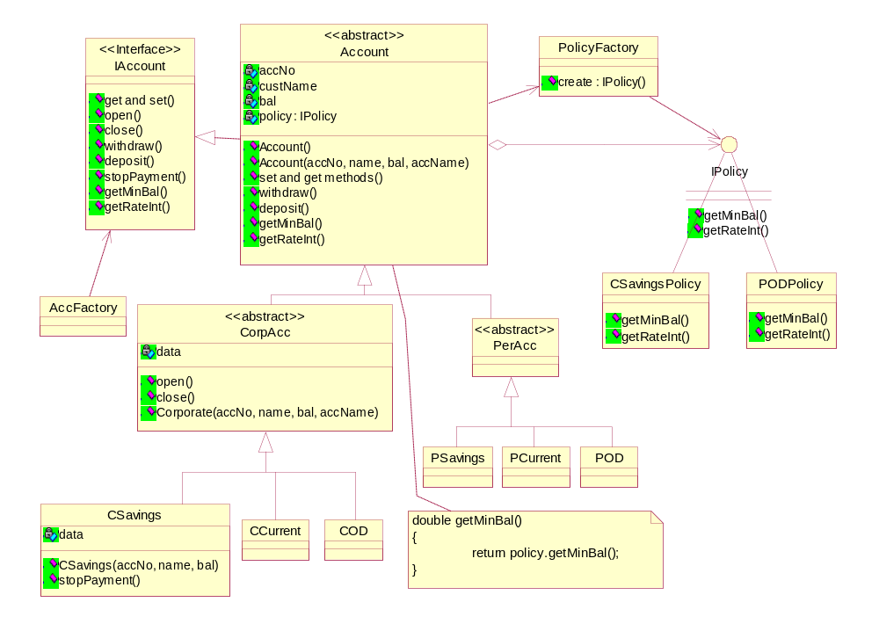
Bridge Pattern - BankApp
Module: Design Patterns Copyright © Venkat Shiva Reddy

Slide 52
Bridge Pattern - Applications
In the previous design consider the following extensions
  What happens when we need to introduce a new type of Account say ‘Mortgage’ account
    This would mean that we need to create the Corporate-Mortgage Account and Personal-Mortgage Account classes
  What happens when we need to introduce a new type of Customer say ‘NRI’ customer
    This would mean that we need to create the NRI-Savings Account, NRI-Current Account, NRI-OD Account and NRI-Mortgage Account classes
The inability to introduce a new type of abstraction without creating more than one class is known as class proliferation
Module: Design Patterns Copyright © Venkat Shiva Reddy

Slide 53
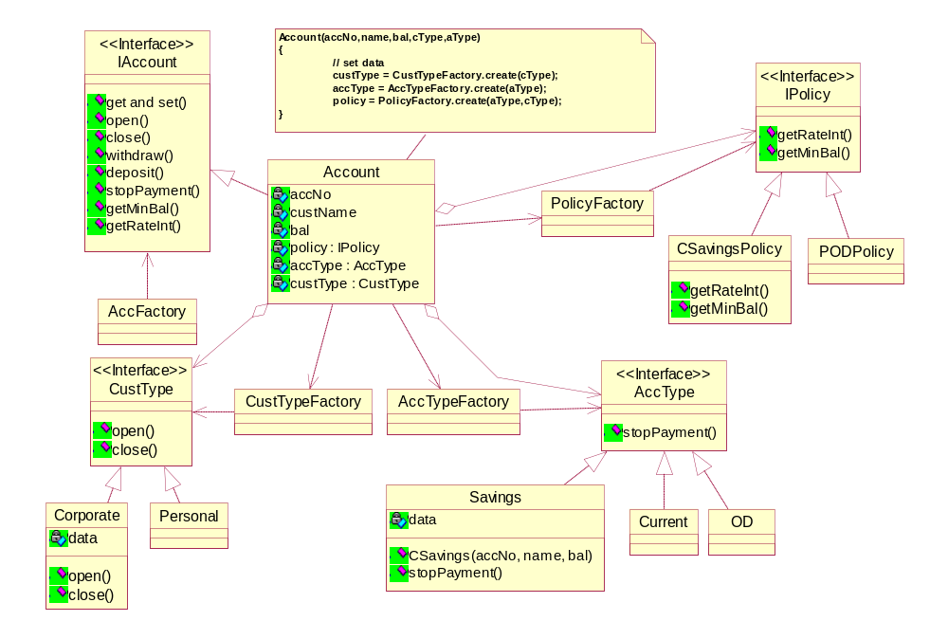
Bridge Pattern – BankApp Solution
Module: Design Patterns Copyright © Venkat Shiva Reddy

Slide 54
Bridge Pattern - Applications
The Bridge Pattern is very useful in hiding the implementations from the clients
If a class has multiple implementations then the common approach is to write subclasses
This essentially means that the implementation details are exposed to the clients as subclasses
It is necessary to hide the implementation details and create good abstractions which is a true measure of good object-oriented design
The implementations can be provided as an Implementation hierarchy which can be bridged with the actual class that is exposed to the client
Module: Design Patterns Copyright © Venkat Shiva Reddy

Slide 55
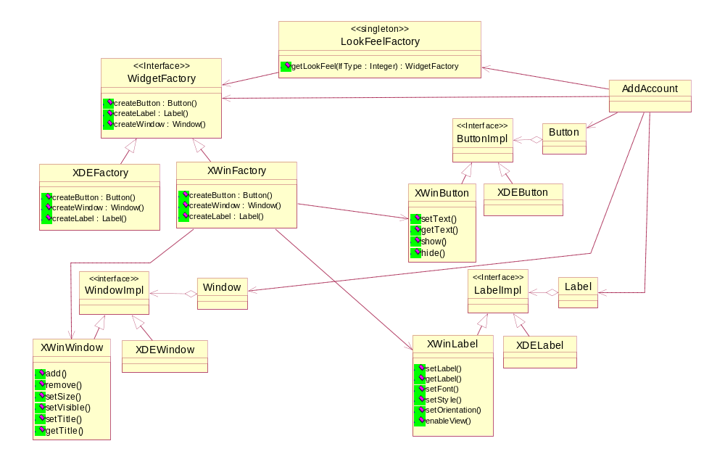
Bridge Pattern – Examples
Module: Design Patterns Copyright © Venkat Shiva Reddy

Slide 56
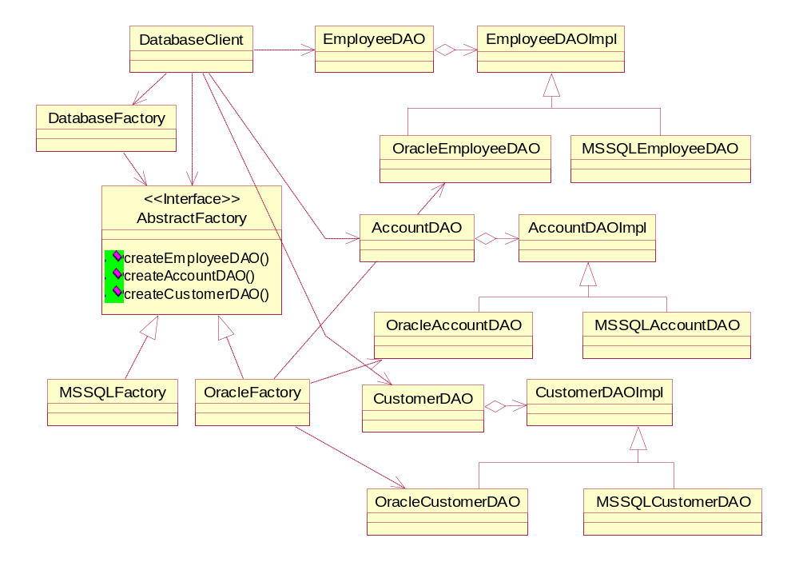
Bridge Pattern – Examples
Module: Design Patterns Copyright © Venkat Shiva Reddy

Slide 57
Bridge Pattern - Applications
The Bridge ensures that the clients use a class without worrying about its implementation details
The previous two examples illustrate this
Notice how the examples discussed in the Abstract Factory pattern are remodeled with a Bridge
The Bridge is configured with the help of an Abstract Factory
Module: Design Patterns Copyright © Venkat Shiva Reddy

Slide 58
The Flyweight Pattern
Intent
  Use sharing to support large number of fine-grained objects efficiently
  Refine the structure of a class by separating the shared structure from the unshared structure so that the number of shared structure instances can be controlled
Module: Design Patterns Copyright © Venkat Shiva Reddy

Slide 59
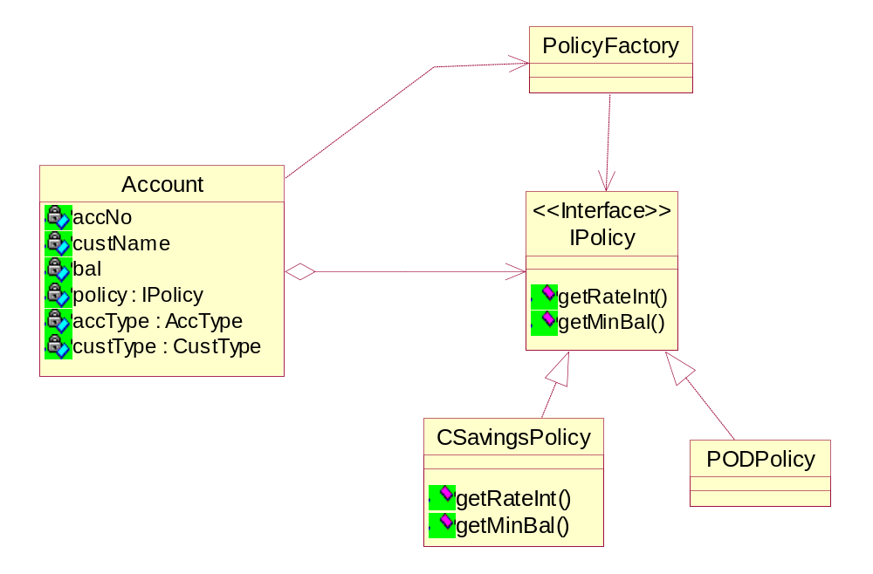
Flyweight Pattern – The Problem
In the BankApp example previously discussed, an Account has different policies
Many accounts of the same account and customer types would use the same policy
Module: Design Patterns Copyright © Venkat Shiva Reddy

Slide 60
Flyweight Pattern – The Problem
It is necessary to define set policy classes as they are presumed to have different implementations for computing minimum balance and rate of interest
It is also necessary to make the whole hierarchy of classes Singletons as a single policy instance can serve many accounts of the same account and customer types
If minimum balance and rate of interest are not computed based on some algorithm, but are values that have to be returned, this would result in hard coding the values in these different policy classes
Also, since the policy values can change, it is required to be able to set and get the minimum balance and rate of interest
One possible solution is to store these attributes minimum balance and rate of interest in the Account class itself
Module: Design Patterns Copyright © Venkat Shiva Reddy

Slide 61
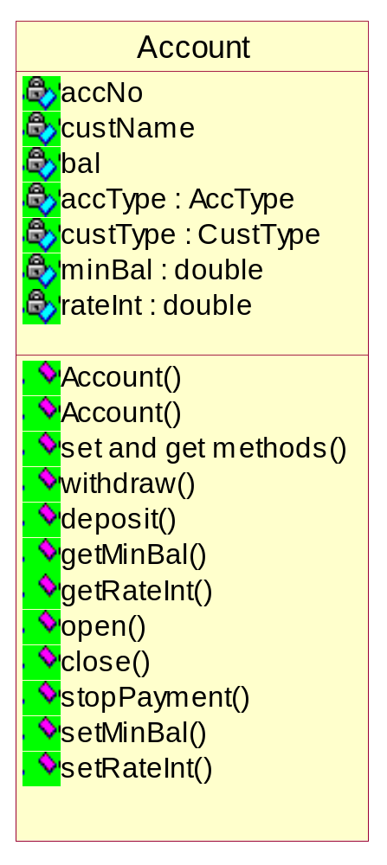
Flyweight Pattern – The Problem
This approach has the following drawbacks
  The Account class has some shared and unshared structure
  The unshared structure (called extrinsic state by GOF), would be required for every Account instance – like accNo, custName, balance, etc…
  The shared structure (called intrinsic state by GOF), would be duplicated for all Accounts of a given account and customer type – like minBal and rateInt
The appropriate solution is to ensure that many instances of Account which belong to the same customer and account type map to the same values of minBal and rateInt
Module: Design Patterns Copyright © Venkat Shiva Reddy

Slide 62
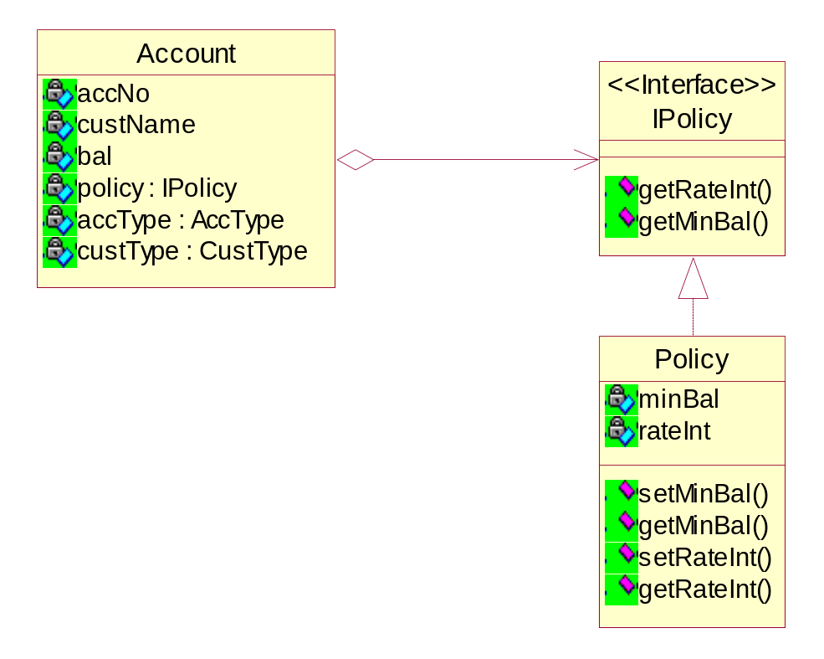
Flyweight Pattern – The Problem
This would require decoupling the shared data from the unshared data
The shared data needs to be separately managed
The class that has the shared data is known as the flyweight
The shared data can be separated from the Account class and placed inside another class known as Policy
Module: Design Patterns Copyright © Venkat Shiva Reddy

Slide 63
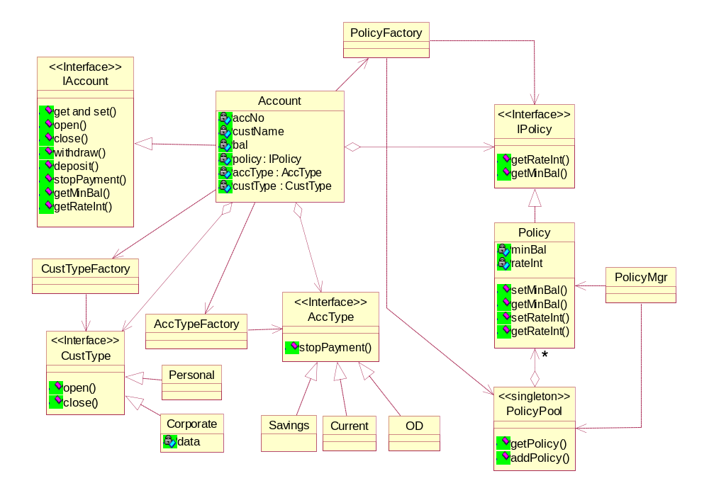
Flyweight Pattern – The Solution
Module: Design Patterns Copyright © Venkat Shiva Reddy

Slide 64
Flyweight Pattern – The Problem
In our case, the policy is represented by the IPolicy interface as it is required to only read values from the Policy class
The values of the Policy class are managed separately by a Policy Manager
The Policy instances are pooled and shared
The pool is separately maintained by a PolicyPool class
In a typical design the factory by itself can pool the instances
The factory picks a policy from the pool and provides the same to the client class (Account)
This ensures that in our design the policy being treated as a flyweight is transparent to the Account class
Module: Design Patterns Copyright © Venkat Shiva Reddy

Slide 65
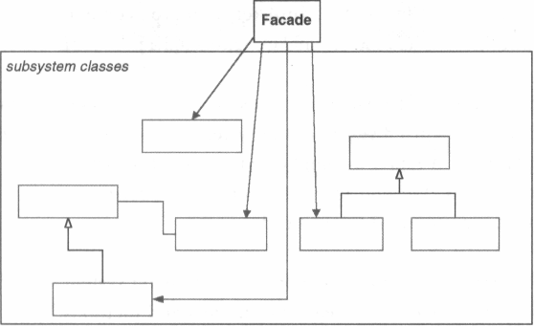
The Façade Pattern
Intent
  Provide a unified interface to a set of interfaces in a subsystem
  Façade defines a higher-level interface that makes the subsystem easier to use
  Easier to filter exceptions thrown by the subsystem and propagate them back to the client as client-identifiable exceptions
Insulating clients from the Sub Systems
Module: Design Patterns Copyright © Venkat Shiva Reddy

Slide 66
Façade Pattern – The Context
Consider the following scenario
These Components have to use the existing Business Components and provide
a Web-enabled UI to the application
C# C1
C# C2
C# C3
The Components in this layer have to be developed in C# and will provide the
application with View and Control Logic
Component1
Component2
Component3
Component4
Component5
The Components in this layer have been developed in C++ and hold the business
rules
Module: Design Patterns Copyright © Venkat Shiva Reddy

Slide 67
Façade Pattern – The Context
The new components which have to be developed need to interface with another subsystem
Each new component may have dependencies on one or more components from the subsystem
There could also be unknown exceptions propagating from the subsystem to these new components
C# C1
C# C2
C# C3
Component1
Component2
Component3
Component4
Component5
Module: Design Patterns Copyright © Venkat Shiva Reddy

Slide 68
Façade Pattern – The Context
In such a scenario the developer of the new components cannot possibly handle these tight dependencies as
  Knowledge of the subsystem would be mandatory before the new components can be fleshed out
  The contexts for handling the exceptions would need to be established
  The mechanisms for accessing the underlying subsystem would be exposed to all the new components
  The team’s capabilities have to also extend to understanding the subsystem and the technology used for the subsystem
Module: Design Patterns Copyright © Venkat Shiva Reddy

Slide 69
Façade Pattern – The Solution
The Façade helps resolve all the problems described before
C# C1
C# C2
C# C3
<<facade>>
BusinessMgr
Component1
Component2
Component3
Component4
Component5
Module: Design Patterns Copyright © Venkat Shiva Reddy

Slide 70
Façade Pattern – The Solution
Advantages
  Abstract the mechanism of accessing the subsystem
  Filter the unknown exceptions from propagating
  Minimize or eliminate platform dependencies
  Facilitate easier development of the new components since all communicate with another component designed by the same team
  Knowledge of the subsystem would be necessary for only the developer of the façade and not the other developers
Module: Design Patterns Copyright © Venkat Shiva Reddy

Slide 71
Façade Pattern – Problem
Every database client class has to get coupled with the classes of the subsystem required to operate on the database
SqlConnection conn = new SqlConnection(“…”);
SqlCommand cmd = conn.CreateCommand(…);
DataReader dr = cmd.ExecuteXXX();
Client
Connection
Command
DataReader
DataSet
Module: Design Patterns Copyright © Venkat Shiva Reddy

Slide 72
Façade Pattern – Solution
The ‘PersistenceFacade’ simplifies access to the subsystem
Client
<<facade>>
Connection
DatabaseMgr
Command
DataReader
DatabaseMgr mgr = DatabaseMgr.getInstance();
DataSet
mgr.addEmployee(employee);
Module: Design Patterns Copyright © Venkat Shiva Reddy

Slide 73
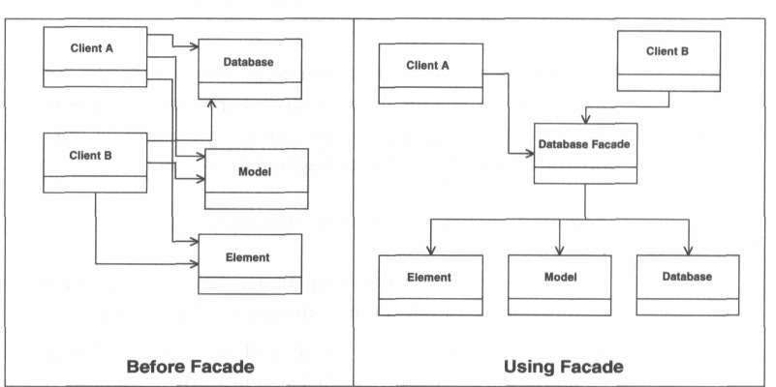
Façade Pattern – Advantage
Module: Design Patterns Copyright © Venkat Shiva Reddy

Slide 74
The Adapter Pattern
Intent
  Convert the interface of a class into another interface that the clients expect
  Adapter lets classes work together that couldn’t otherwise because of incompatible interfaces
Also known as
  Wrapper
Module: Design Patterns Copyright © Venkat Shiva Reddy

Slide 75
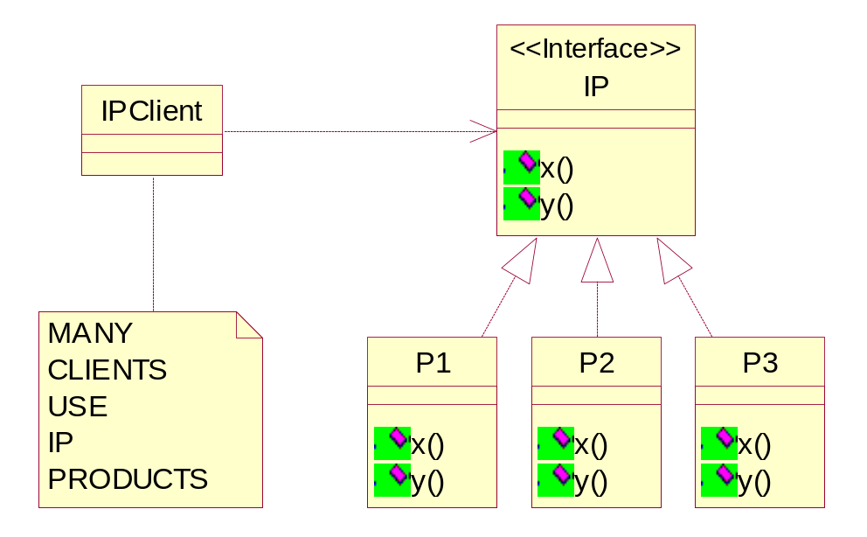
Adapter Pattern – Context 1
Consider a scenario where, many client classes use set of products P1, P2, P3, etc. All these products expose the interface IP which the clients commit to
Let us suppose that one of the components P3 does not meet with the complete needs of the clients
In a typical case, the cost of redeveloping this component could be high, due to its large dependencies and hence a better approach would be to identify some components developed in-house or provided by third-parties which meet the client requirements
Module: Design Patterns Copyright © Venkat Shiva Reddy

Slide 76
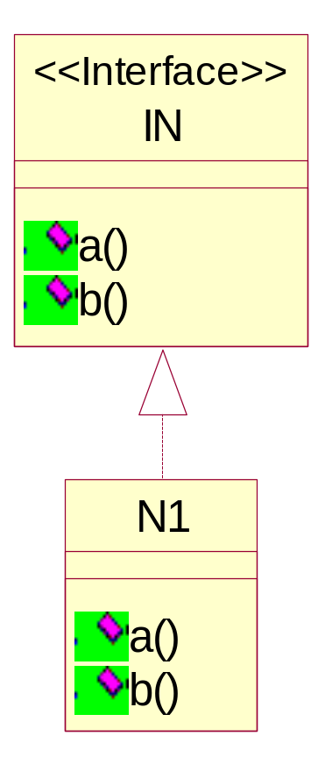
Adapter Pattern – Context 1
The team therefore identifies some third-party component which can be used instead of P3
The problem however in this case would be that the interface exposed by the third party component does not comply with the current interface committed to by the clients
To incorporate this new component, the clients have to be changed which would have a cascaded impact on all the clients code
Module: Design Patterns Copyright © Venkat Shiva Reddy

Slide 77
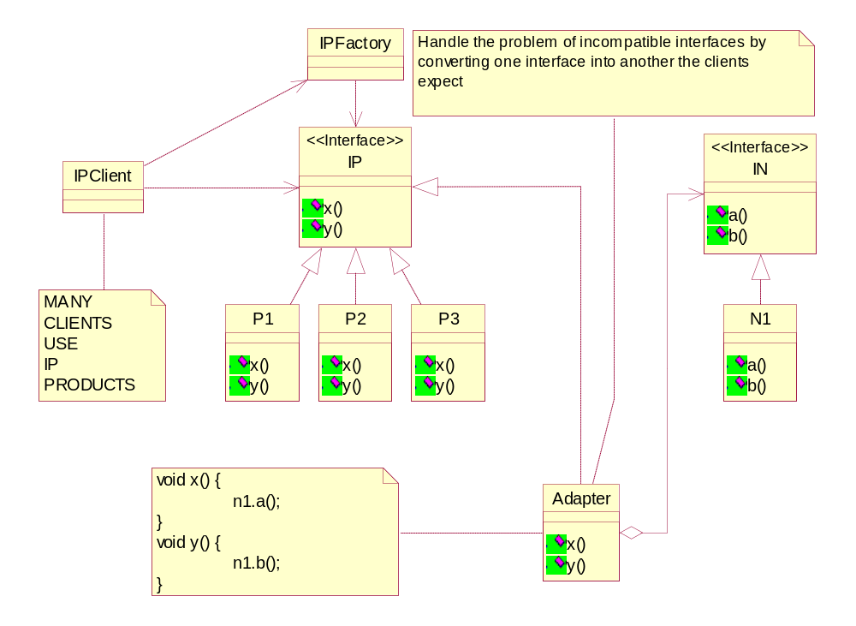
Adapter Pattern – Solution
Module: Design Patterns Copyright © Venkat Shiva Reddy

Slide 78
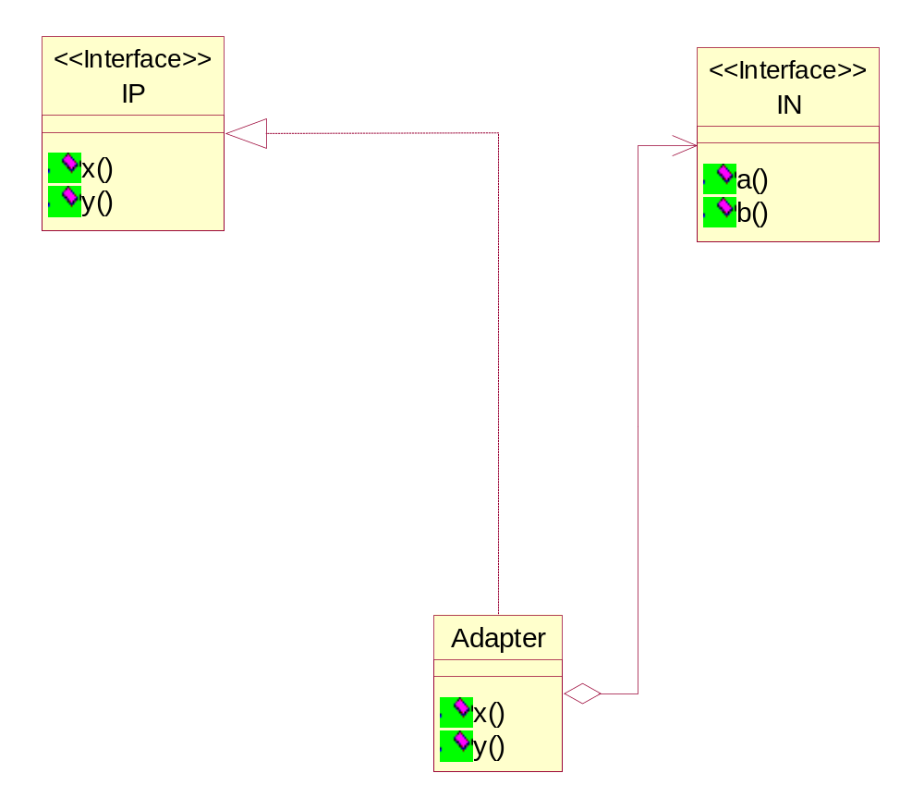
The Adapter Pattern
The adapter used in the previous case is a Generic Adapter
Generic Adapter
Module: Design Patterns Copyright © Venkat Shiva Reddy

Slide 79
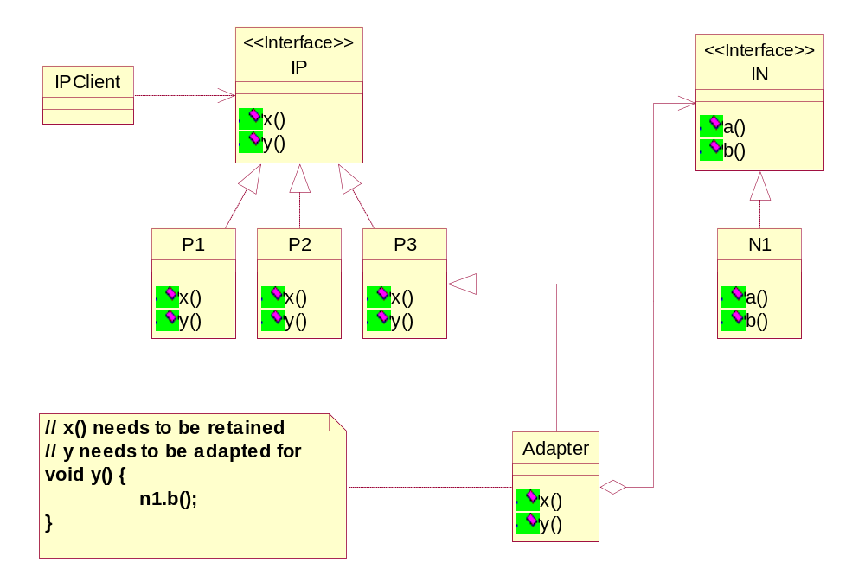
Adapter Pattern – Context 2
Let us suppose that, part of the component P3’s functionalities need to be retained while the other implementations need to be adapted for
In this case we need a Partial Adapter
Module: Design Patterns Copyright © Venkat Shiva Reddy

Slide 80
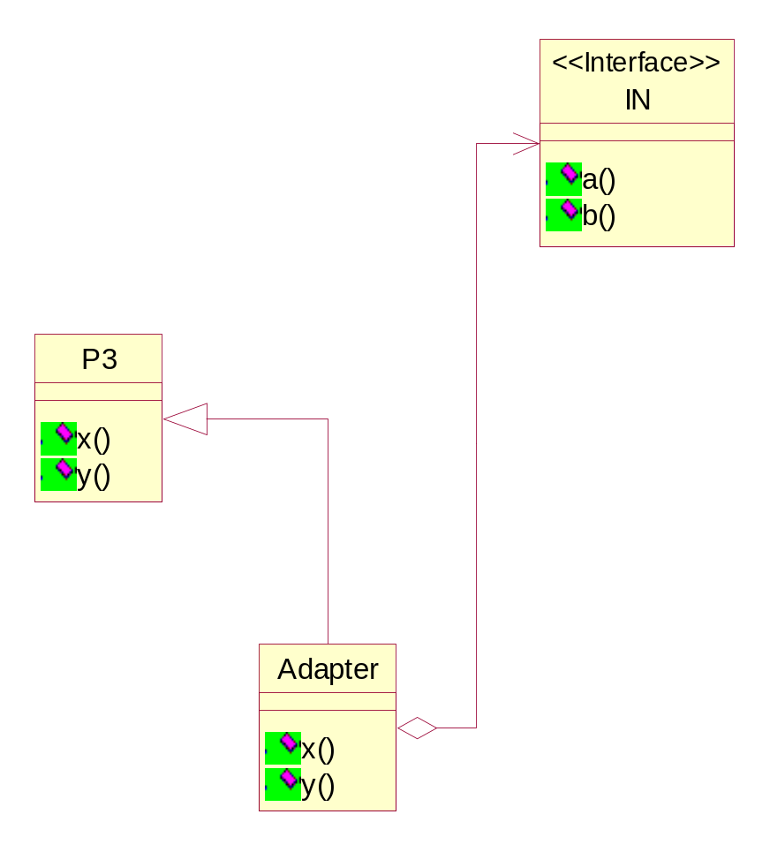
Adapter Pattern – Partial Adapter
The adapter used in the previous case is a Dedicated Partial Adapter
This is also known as a Class Adapter
Dedicated
Partial Adapter
Module: Design Patterns Copyright © Venkat Shiva Reddy

Slide 81
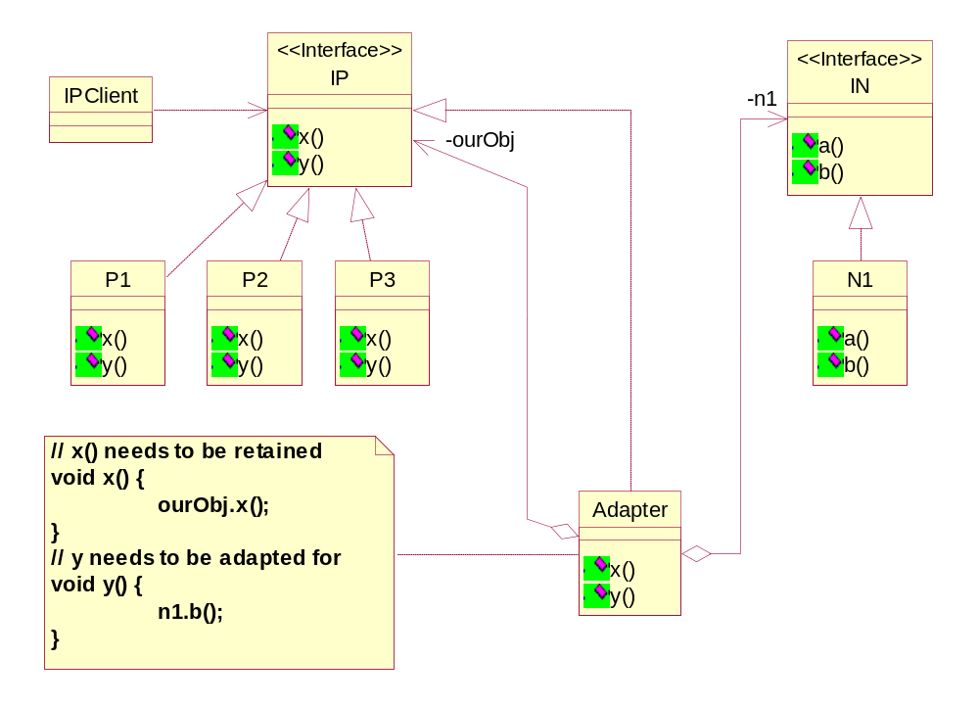
Adapter Pattern – Context 3
Let us suppose that, part of the all the components’ functionalities need to be retained while the other implementations for all the components P1, P2, P3, etc. need to be adapted for
In this case we need a Generic Partial Adapter
Module: Design Patterns Copyright © Venkat Shiva Reddy

Slide 82
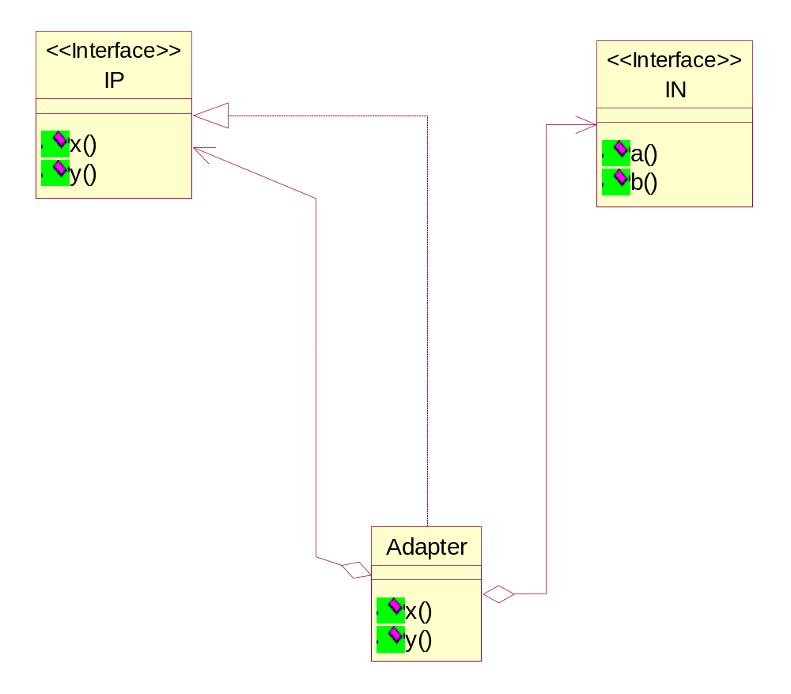
Adapter Pattern – Partial Adapter
The adapter used in the previous case is a Generic Partial Adapter
This is an Object Adapter
Generic
Partial Adapter
Module: Design Patterns Copyright © Venkat Shiva Reddy

Slide 83
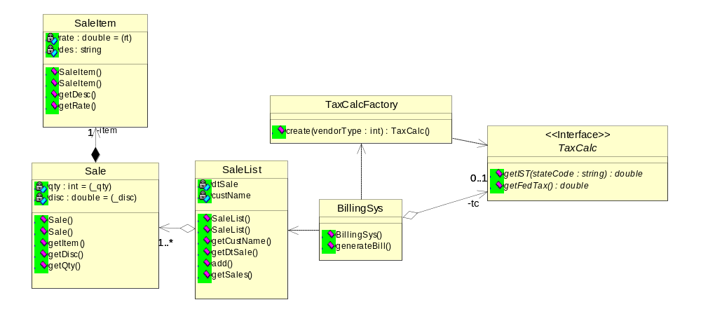
Adapter Pattern – Application
Consider the following case
In this example, the Billing System is committed to using a TaxCalc which provides the interface for computing IST(Inter State Tax) and fedTax (federal tax)
The Billing System gets configured with a TaxCalc by using the TaxCalcFactory
Module: Design Patterns Copyright © Venkat Shiva Reddy

Slide 84
Adapter Pattern – Application
An illustration of the code is presented here
  class BillingSys {
  private TaxCalc tc;
  public BillingSys(int vendorType) {
  tc = TaxCalcFactory.getTaxCalc(vendorType);
  }
  public void generateBill(SaleList list) {
  double ist = tc.getIST("Ohio");
  double fedTax = tc.getFedTax();
  double grandTot=0;
  // compute grandTot...
  double tax = (ist/100) * grandTot + (fedTax/100) * grandTot;
  grandTot = grandTot + tax;
  }
  }
Module: Design Patterns Copyright © Venkat Shiva Reddy

Slide 85
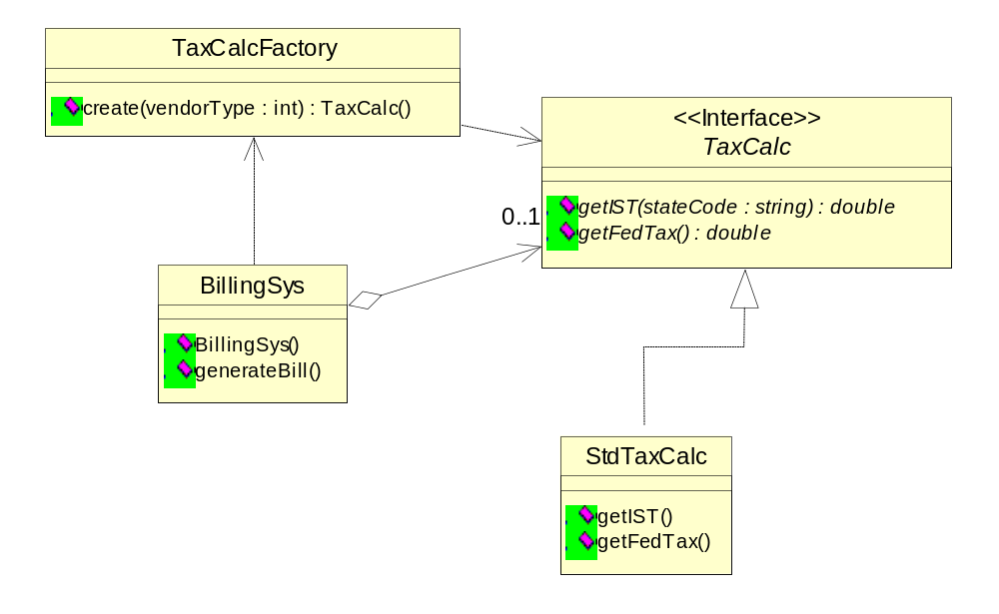
Adapter Pattern – Application
We have designed a TaxCalc known as the StdTaxCalc which provides the IST and fedTax
Module: Design Patterns Copyright © Venkat Shiva Reddy

Slide 86
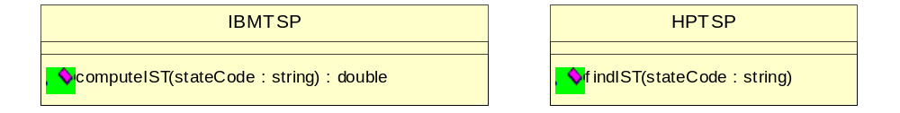
Adapter Pattern – Application
We later have complaints from a few clients that the IST is not always consistent with the rules for that particular state
We also acknowledge that as we lack expertise in this area that it would be more prudent to allow our application to interface with different service providers to achieve the same
We have currently identified some service providers who provide the ISTs for different states
We may need to support interfacing with other service providers in the near future
The different service providers would typically expose different interfaces
We can however retain our implementation of federal tax as the rules are centralized across the country and do not get revised frequently
We might also have to adapt for the IST implementations of our new TaxCalc implementations
The key here is to use a proper Generic Partial Adapter
Module: Design Patterns Copyright © Venkat Shiva Reddy

Slide 87
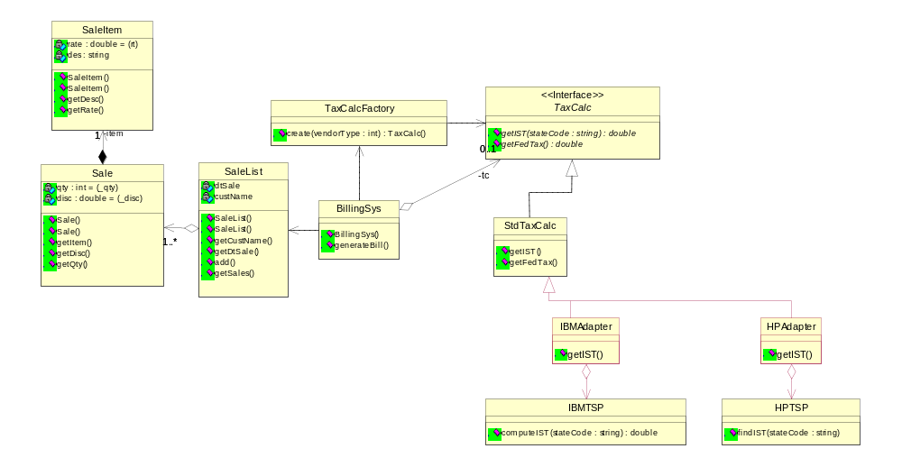
Adapter Pattern – Solution 1
In this case, the adapters act as dedicated partial adapters and cannot work with different implementations of our TaxCalc
Module: Design Patterns Copyright © Venkat Shiva Reddy

Slide 88
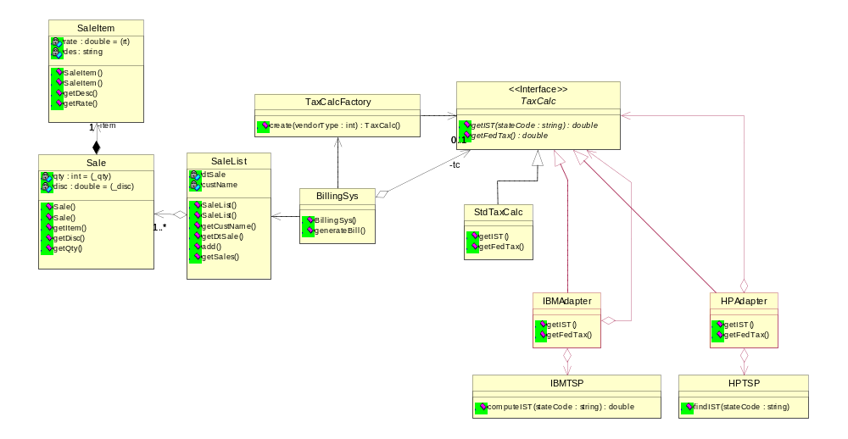
Adapter Pattern – Solution 2
In this case, the adapters are generic partial adapters and can work with different implementations of our TaxCalc, but there is redundancy in the design
Module: Design Patterns Copyright © Venkat Shiva Reddy

Slide 89
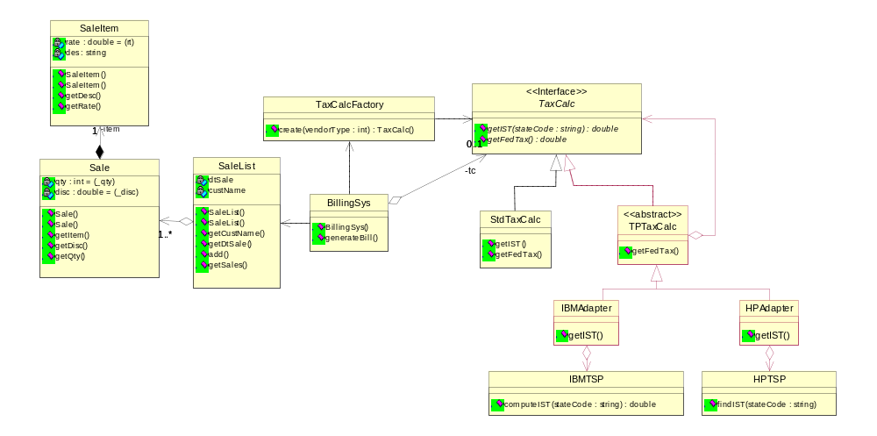
Adapter Pattern – Solution 3
This is a good design, but however the adapters which are lower level components are exposed to the TaxCalcFactory which is at a higher level. The adapters can be further abstracted.
Module: Design Patterns Copyright © Venkat Shiva Reddy

Slide 90
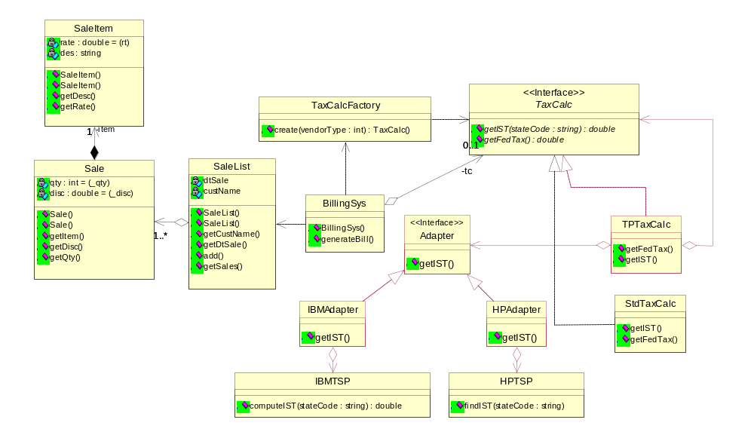
Adapter Pattern – Solution 4
In this case, the TaxCalcFactory creates either our TaxCalc implementations or the TPTaxCalc. The adapters are not directly exposed to a lower level component. This is achieved with a bridge.
Module: Design Patterns Copyright © Venkat Shiva Reddy

Slide 91
The Proxy Pattern
Intent
  Provide a surrogate or placeholder for another object to control access to it
Also known as
  Surrogate
Module: Design Patterns Copyright © Venkat Shiva Reddy

Slide 92

Proxy Pattern – The Context
Consider a case wherein a Text Editor needs to display the contents of a document. The document contains many components including images.
To avoid loading of expensive objects like images and instead load them on demand a proxy can be used
The image may not be locally available and needs to be downloaded or the editor has to wait for availability
The client needs to asynchronously make the image available
In such cases, a proxy would be useful as it can act as a stand-in for the real image
The proxy has a reference to the actual image or its location and should realize the same interface as that of the Image to make it transparent to the clients
Module: Design Patterns Copyright © Venkat Shiva Reddy

Slide 93


Proxy Pattern
The Proxy can be designed in the following two ways
It is a combination of the ‘is-a’ and the ‘has-a’ relationships
The ‘has-a’ form is association as the proxy is not a whole of the actual subject
Module: Design Patterns Copyright © Venkat Shiva Reddy

Slide 94

The Remote Proxy
The Remote Proxy can be used for providing a local representation for an object in a different address space
The RMI mechanism in Java presents the client-side proxy as a stub and the server side proxy as a skeleton
Module: Design Patterns Copyright © Venkat Shiva Reddy

Slide 95
Proxy Pattern - Application
In the previous case study, the POS Application, we have seen the use of adapters for interfacing with different service providers
This presents us with a new problem
The service providers might not be available temporarily
The service providers might throw different types of exceptions
In case of the Billing System, it would be infeasible to abort the sales, just because the service provider is not accessible
Ideally the sale should go ahead and the customer can be taxed based on some failover support
The Billing System would now have to deal with the lack of availability of the service, exceptions of different types, handle failures, provide failover support and possibly have an extensible mechanism for providing failover support
Over a period of time different failover strategies can be devised like say using the StdTaxCalc instead, or reading from a table where values of the previous access are logged, or read an XML, or run a service, etc.
The design needs to address all the above concerns and provide extensibility
Module: Design Patterns Copyright © Venkat Shiva Reddy

Slide 96

Proxy Pattern - Solution
The ServiceProxy realizes the same interface ‘TaxCalc’ and has an association with the ‘TaxCalc’
This ensures that the ServiceProxy is transparent to the Billing System
This proxy can be used as a surrogate for any type of TaxCalc, and hence holds a reference of the interface TaxCalc
Module: Design Patterns Copyright © Venkat Shiva Reddy

Slide 97

Failover handling
The proxy is decoupled from the failover handling which is implemented with a set of failover strategies
A new failover Strategy can always be designed
Module: Design Patterns Copyright © Venkat Shiva Reddy

Slide 98

Plugging in the Proxy with FailOver
Module: Design Patterns Copyright © Venkat Shiva Reddy

Slide 99
Question time
Please try to limit the questions to the topics discussed during the session.
Participants are encouraged to discuss other issues during the breaks.
Thank you.
Module: Design Patterns Copyright © Venkat Shiva Reddy

Slide 100
Unit 3
GOF Behavioral Patterns
Module: Design Patterns Copyright © Venkat Shiva Reddy

Slide 101
GOF Behavioral Patterns
Topics
  Command
  Chain of responsibility
  Template Method
  State
Module: Design Patterns Copyright © Venkat Shiva Reddy

Slide 102
Command Pattern
Intent
  Encapsulate a request as an object, thereby letting you parameterize clients with different requests, queue or log requests, and support undoable operations
Also known as
  Action, Transaction, Functor or Function Object
Module: Design Patterns Copyright © Venkat Shiva Reddy

Slide 103

Command Pattern – The Context
Module: Design Patterns Copyright © Venkat Shiva Reddy

Slide 104

Command Pattern – The Solution
Module: Design Patterns Copyright © Venkat Shiva Reddy

Slide 105

Command Pattern – Application
Module: Design Patterns Copyright © Venkat Shiva Reddy

Slide 106
Command Pattern - Uses
Handling the Database requests can be designed using the Command Pattern
The J2EE Front Controller Pattern is an illustration of the Command Pattern
In an editor, Cut, Copy, Paste are all command objects
  It is hence possible to create a Do List and an Undo List
The Delegation Event Model uses the command pattern in the form of handlers for handling events
Module: Design Patterns Copyright © Venkat Shiva Reddy

Slide 107
Chain of Responsibility Pattern
Intent
  Avoid coupling the sender of a request to its receiver by giving more than one object a chance to handle the request
  Chain the receiving objects and pass the request along the chain until an object handles it
Module: Design Patterns Copyright © Venkat Shiva Reddy

Slide 108

Chain of Responsibility – The Context
Consider the following set of classes
The Clients need to invoke a sequence of operations which are defined in different classes, which all share a common interface
Each operation needs to be invoked based on the result of the previous operation
New sequence of operations can be introduced for new requests
Existing sequence of operations can be changed
The clients can also perform the sequence of operations asynchronously
Module: Design Patterns Copyright © Venkat Shiva Reddy

Slide 109

Chain of Responsibility – The Context
The client is very tightly coupled to both the sequence of operations and to the implementation classes as the interface doesn’t serve the purpose of existence
Module: Design Patterns Copyright © Venkat Shiva Reddy

Slide 110

Chain of Responsibility – The Solution
Module: Design Patterns Copyright © Venkat Shiva Reddy

Slide 111

Chain of Responsibility – Application
Let us suppose for certain requests, a series of validations need to be done like Null Validation, Session Validation, etc.
The sequence of validations can vary for different requests and new sequences can also be created
Only if the initial validation is successful, then the next validation needs to be done
A chain of validators can be created where each validator forwards a valid request to the next validator till the last validator
Module: Design Patterns Copyright © Venkat Shiva Reddy

Slide 112

Chain of Responsibility – Example
Module: Design Patterns Copyright © Venkat Shiva Reddy

Slide 113
Chain of responsibility - Uses
Database commands can be chained at runtime to customize the queries
The J2EE Intercepting Filter Pattern is an illustration of the Chain of Responsibility Pattern
Module: Design Patterns Copyright © Venkat Shiva Reddy

Slide 114
Template Method Pattern
Intent
  Define the skeleton of an algorithm in an operation, deferring some steps to subclasses
  Template Method lets subclasses redefine certain steps of an algorithm without changing the algorithm’s structure
Module: Design Patterns Copyright © Venkat Shiva Reddy

Slide 115

Template Method – The Context
Consider the following set of classes
x() is a non-polymorphic method and hence cannot be overridden in the subclasses
Typically any client who invokes this method should get the same output
Module: Design Patterns Copyright © Venkat Shiva Reddy

Slide 116
Template Method – The Context
abstract class A {
final public void x() {
y();
}
abstract protected void y();
}
class A1 extends A {
protected void y() { System.out.println("A1.y()"); }
}
class A2 extends A {
protected void y() { System.out.println("A2.y()"); }
}
class Client {
static void execute(A a) {
a.x(); // this is a non-polymorphic method - ideally should give the same output
// but this gives different outputs
}
}
class TemplateDemo1 {
public static void main(String args[]) {
Client.execute(new A1());
Client.execute(new A2());
}
}
Module: Design Patterns Copyright © Venkat Shiva Reddy

Slide 117
Template Method – The Context
Why should the method x() be made to vary in this manner?
If x() is an algorithm, then by employing the previous technique, certain steps of the algorithm can be redefined without changing the algorithm’s structure
Template Methods can be useful in implementing the Chain of Responsibility pattern
  The forwarding to the next element in the chain is the responsibility of every element in the chain
  If the forwarding is not done, the chain does not make sense
  Basically, every operation needs to implement some rules which can be redefined by the subclasses and finally the forwarding to the next element needs to be done
  This forwarding mechanism can be implemented in the base class and each subclass can now focus on only implementing the rules
An sample code is presented next without the template method being applied
Module: Design Patterns Copyright © Venkat Shiva Reddy

Slide 118
Template Method – The Context
  abstract class IValidator {
  private IValidator next;
  public IValidator getNext() {
  return next;
  }
  public void add(IValidator val) {
  next = val;
  }
  public abstract boolean validate(String request);
  }
  class NullValidator extends IValidator {
  public boolean validate(String request) {
  boolean valid = true;
  System.out.println("\nNull validation performed");
  IValidator next = getNext();
  if(next != null)
  return next.validate(request);
  else
  return valid;
  }
  }
Module: Design Patterns Copyright © Venkat Shiva Reddy

Slide 119
Applying the Template Method
  abstract class IValidator {
  private IValidator next;
  public void add(IValidator val) {
  next = val;
  }
  final public boolean validate(String request) {
  boolean valid = validateRequest(request);
  if(valid == true && next != null)
  valid = next.validate(request);
  return valid;
  }
  abstract boolean validateRequest(String request);
  }
  class NullValidator extends IValidator {
  boolean validateRequest(String request) {
  boolean valid = true;
  System.out.println("\nNull validation performed");
  return valid;
  }
  }
  class AccessValidator extends IValidator {
  boolean validateRequest(String request) {
  boolean valid = true;
  System.out.println("User access validation performed");
  return valid;
  }
  }
Module: Design Patterns Copyright © Venkat Shiva Reddy

Slide 120
The State Pattern
Intent
  Allow an object to alter its behavior when its internal state changes
  The object will appear to change its class
Also known as
  Objects for States
Module: Design Patterns Copyright © Venkat Shiva Reddy

Slide 121

State Pattern – The Context
Consider the Loan class which has loan related information and methods
The loan processing happens as follows
  A new loan created is logged-in
  A logged-in loan is sent for Verification and RCU Approval
  A loan can be sent for Eligibility check only if both Verification and RCU are done
  A loan goes for Approval after eligibility check
  A loan which is approved goes for purchasing (i.e. documentation)
  A loan which is purchased is disbursed
  A loan can be cancelled at any stage after login
  A loan can be rejected only by the RCU Mgr or the Approval Mgr
  A disbursed, rejected or cancelled loan cannot be further processed
Module: Design Patterns Copyright © Venkat Shiva Reddy

Slide 122
State Pattern – The Context
In a workflow as complex as this, it would be very difficult to take state-specific actions inside methods by using if-else-if constructs
For every state-specific action, the state of the loan can change
Changing the transition (state change) rules or introducing new states would be difficult
Furthermore, if the workflow needs to be customizable, then runtime configurability is required
The State Pattern would be the ideal one to solve these problem
Module: Design Patterns Copyright © Venkat Shiva Reddy

Slide 123
State Pattern – The Solution
Identify the Non-State Specific Methods (NSSM) and the State-Specific Methods (SSM)
In our example, the following are the NSSM and SSM
NSSM
  setLoanNo
  getLoanNo
  setCustName
  getCustName
  Set methods
  Get methods
SSM
  Login
  sendForVerification
  logVerification
  logRCU
  setEligibility
  Approve
  Purchase
  Disburse
  Cancel
  reject
Module: Design Patterns Copyright © Venkat Shiva Reddy

Slide 124

State Pattern – The Solution
Module: Design Patterns Copyright © Venkat Shiva Reddy

Slide 125
State Pattern – The Solution
Identify the different States as classes and map the SSM methods to the specific state classes
Define a super class for all the state classes which by default provides an implementation for all the SSM
  The implementation would however throw an exception or be stubbed out in order to handle an improper SSM invocation for an object in a given state
  Typically if an invalid SSM is invoked on an object, then an Exception is thrown
The loan class delegates all the SSM to the state objects and passes its reference to the delegated methods
Each SSM provides the required implementation and if a transition to the next state is demanded, the same is effected on the loan object using the reference passed
  The transition can be customized by making all the subclasses invoke the super class’s changeState method and passing to it the state name, SSM name and the loan object’s reference
The super class can in turn get the next state from a State Machine or a Factory to effect the transition
Module: Design Patterns Copyright © Venkat Shiva Reddy

Slide 126
Question time
Please try to limit the questions to the topics discussed during the session.
Participants are encouraged to discuss other issues during the breaks.
Thank you.
Module: Design Patterns Copyright © Venkat Shiva Reddy

